Slide 1
AS/A Level History

Slide 2
Why study History?
It is highly regarded by universities and employers
You can gain an advanced understanding of how the world became what it is today
You can develop transferable and written skills, including critical thinking, analysis and debate
It can spark a lifelong interest in making sense of the past

Slide 3
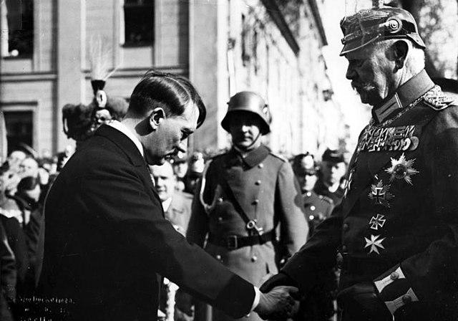
What will I study?
Year 13
AS 1: Historical Investigations and interpretations
Germany 1919-1945
50% of AS and 20% of A Level
AS 2: Historical Conflict and Change
Russia 1914-1941
50% of AS and 20% of A Level

Slide 4
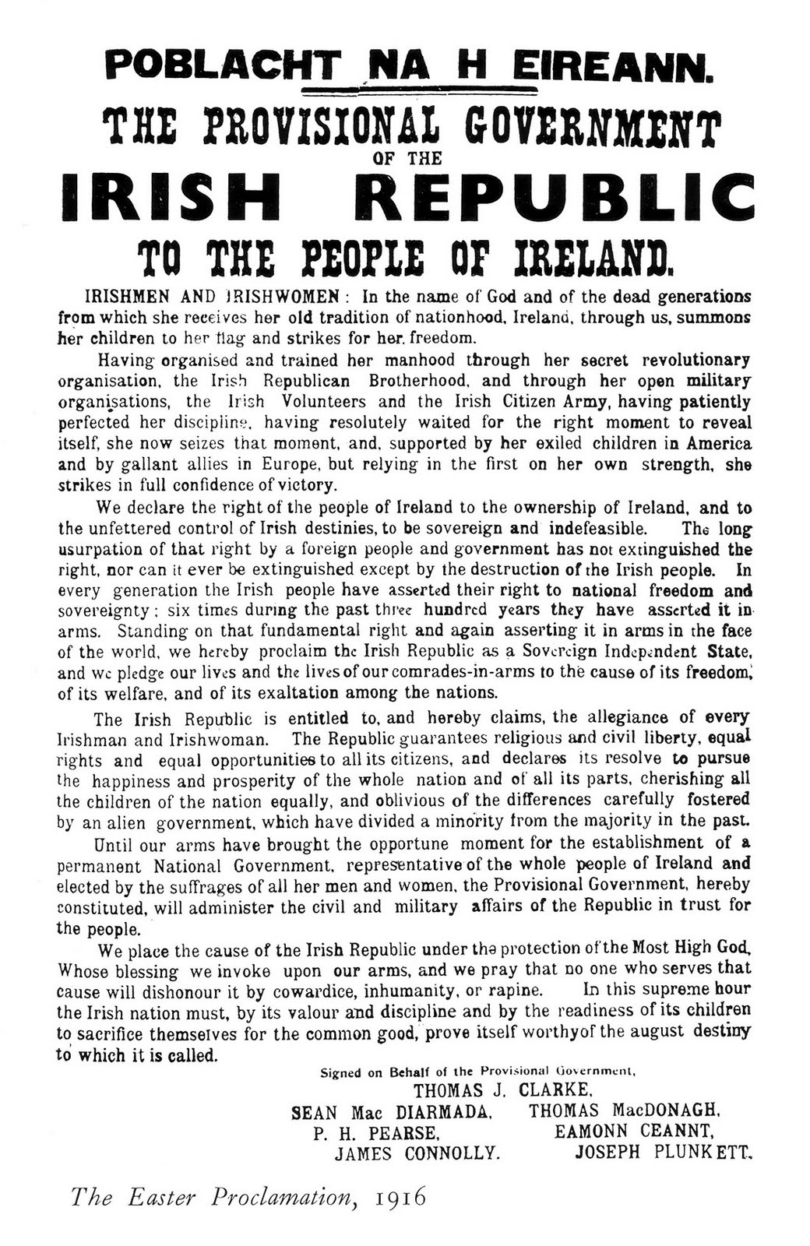
What will I study?
Year 14
A21: Change Over Time
Clash of Ideologies in Europe 1900-2000
20% of A Level
A22: Historical Investigations and Interpretations
Ireland 1900-1925
40% of A Level

Slide 5
How will I be assessed?
Content | Assessment
AS 1: Germany 1919-1945 | External Exam 1 hour 30 mins
AS 2: Russia: 1914-1941 | External Exam 1 hour 30 mins
A21: Clash of Ideologies | External Exam 1 hour 15 mins
A22: Ireland 1900-1925 | External Exam 2 hours 30 mins

Slide 6
How can I find out more?
Email Mrs Speers if you have any questions: fspeers638@c2kni.net
Speak to someone in Year 13 or 14 who is already studying History!

